Slide 1
Data Science
Salaries!

Slide 2
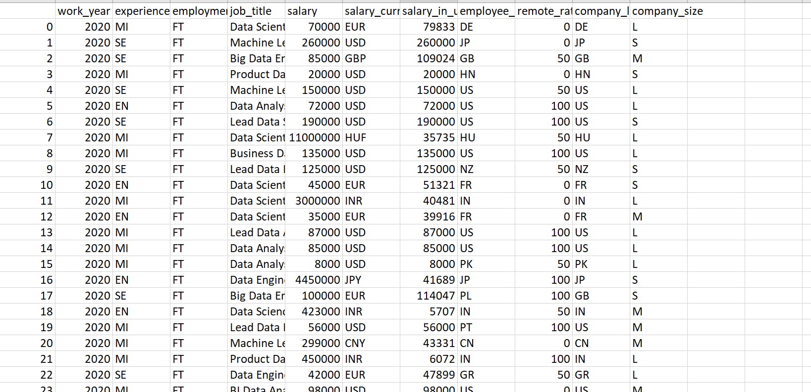
The Dataset
Fields: work year, experience levels, employment type, job_title, salary, salary currency, salary in USD, employee residence country, company location, percentage remote work, company size
606 Datapoints
.
Notes:
Before we can do any analysis, we need to understand what we’re analysing. I looked at a dataset of data science salaries

Slide 3
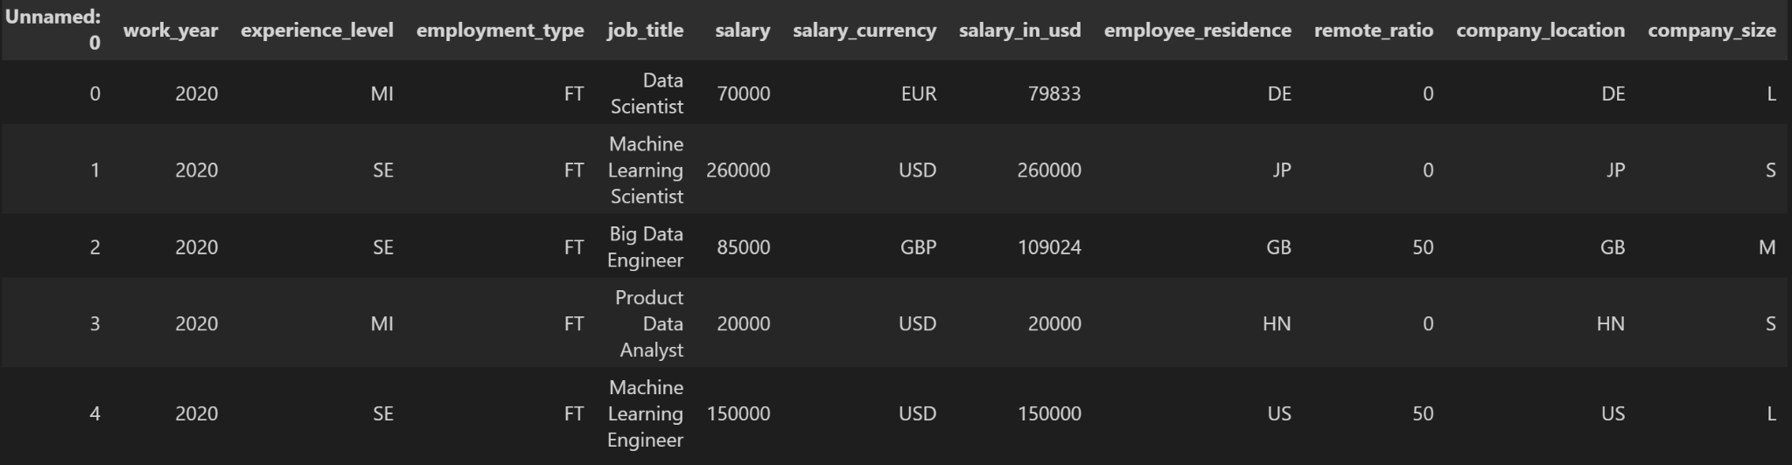
The Dataset

Slide 4
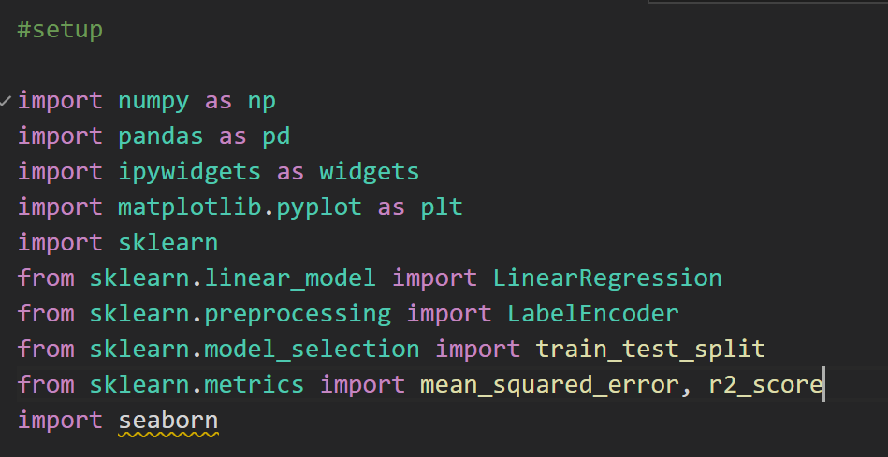
The Modules

Slide 5
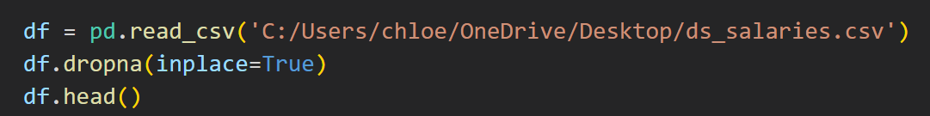
CLEANING THE DATASET
Removing NaN
Using .dropna to remove any rows with missing data
What’s Useful?
Very useful:
Not (asa) useful: salary_currency, work_year, remote_ratio

Slide 6
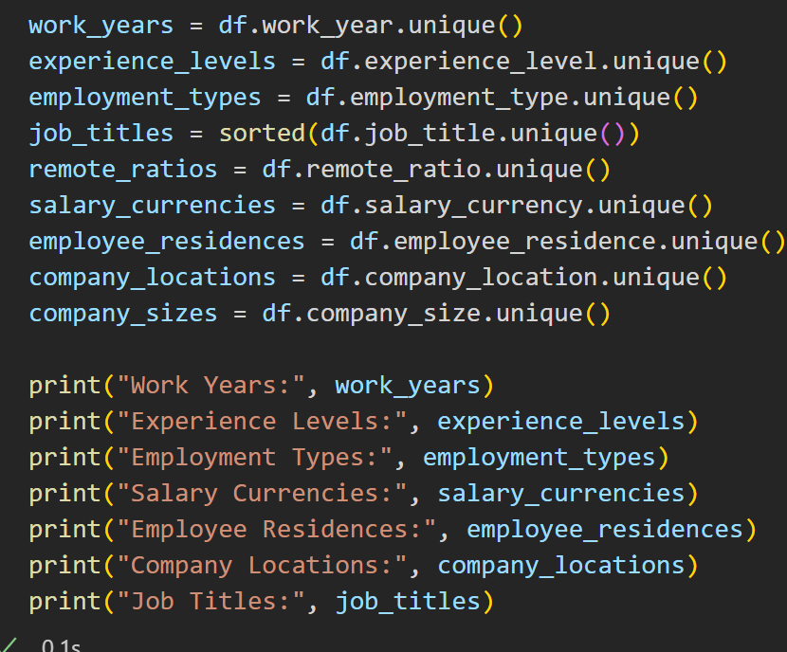
Reading in Data
1) read in all the unique values for each field
use df.<field>.unique()
2) output
allows the audience to clearly see all the possible values in each field

Slide 7
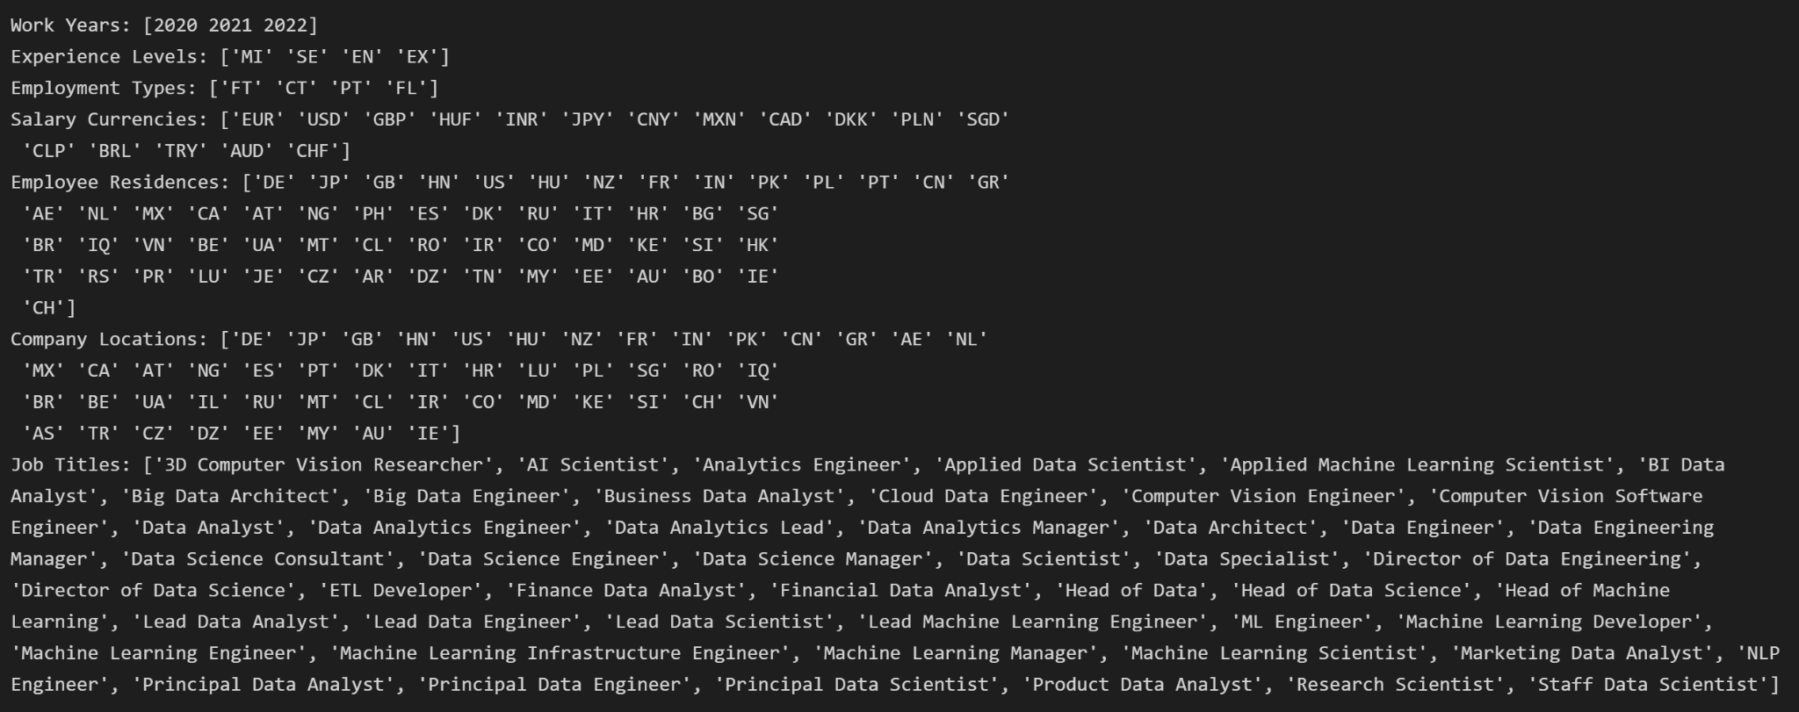
Reading in Data

Slide 8
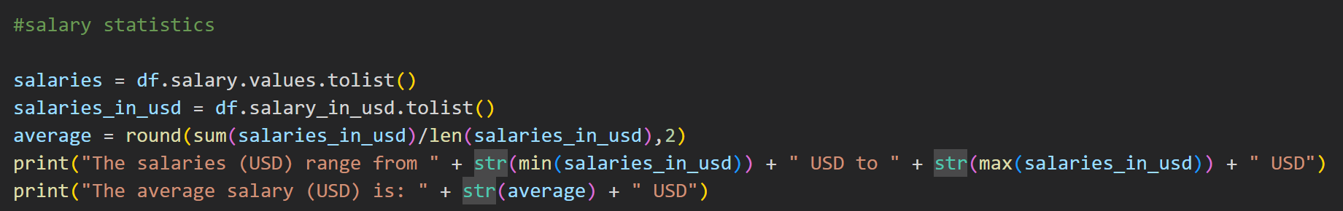
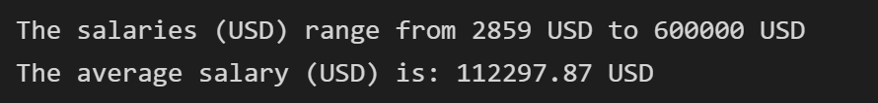
BASIC STATISTICS
Salary Ranges
1. read in data into a list []
2. Average: sum/number
3. Range: min - max
(Disclaimer)
data includes positions requiring years of exp. so we won’t make this much right out of uni :((

Slide 9
(SLIGHTLY LESS) BASIC STATISTICS
1. Group by
sort and group the data by job title
Iterate through each group
2. Analyse groups
Apply earlier code to each group of “job titles”
find sum, min, max, avg, range, etc.

Slide 10
(SLIGHTLY LESS) BASIC STATISTICS
3. Store
create a temporary list for each group
store all the stats → that temporary list
4. Store (again)
store each list as an item in a dictionary
dictionary structure:
(key): the job title
(value): the stats for that title

Slide 11
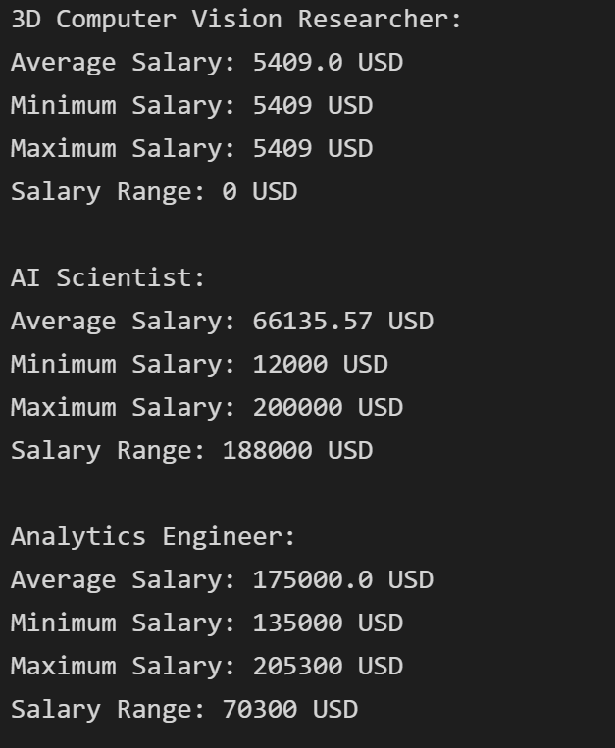
(SLIGHTLY LESS) BASIC STATISTICS
5. Print
iterate through each item in the dictionary
print out the statistics for each job title

Slide 12
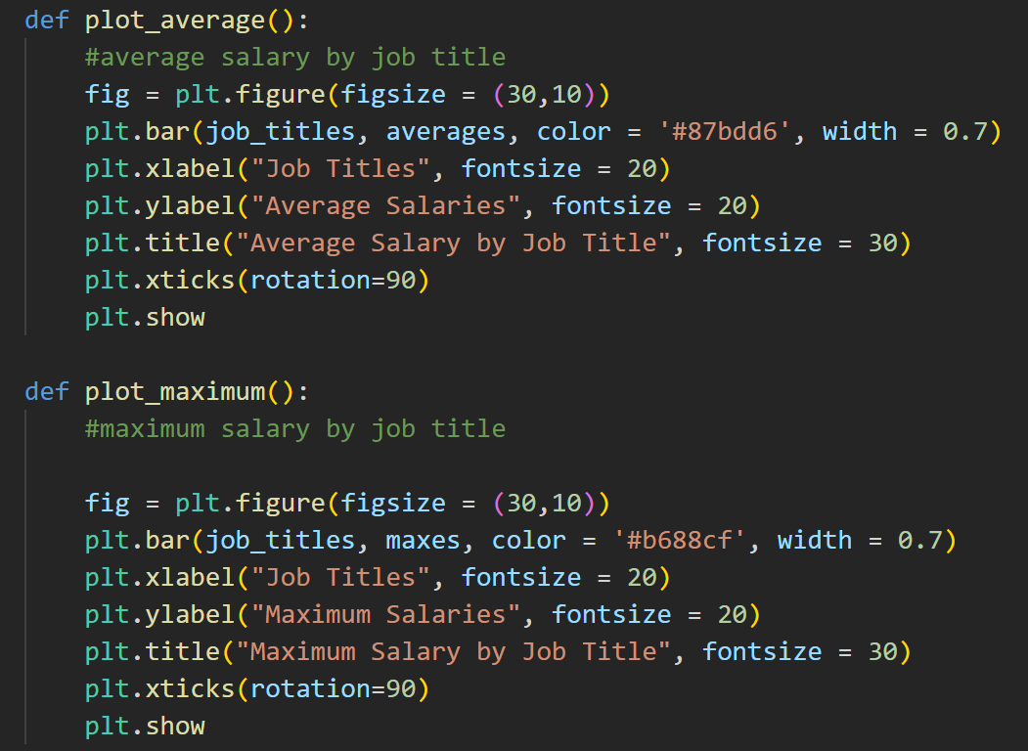
Statistics and Visualisation

Slide 13
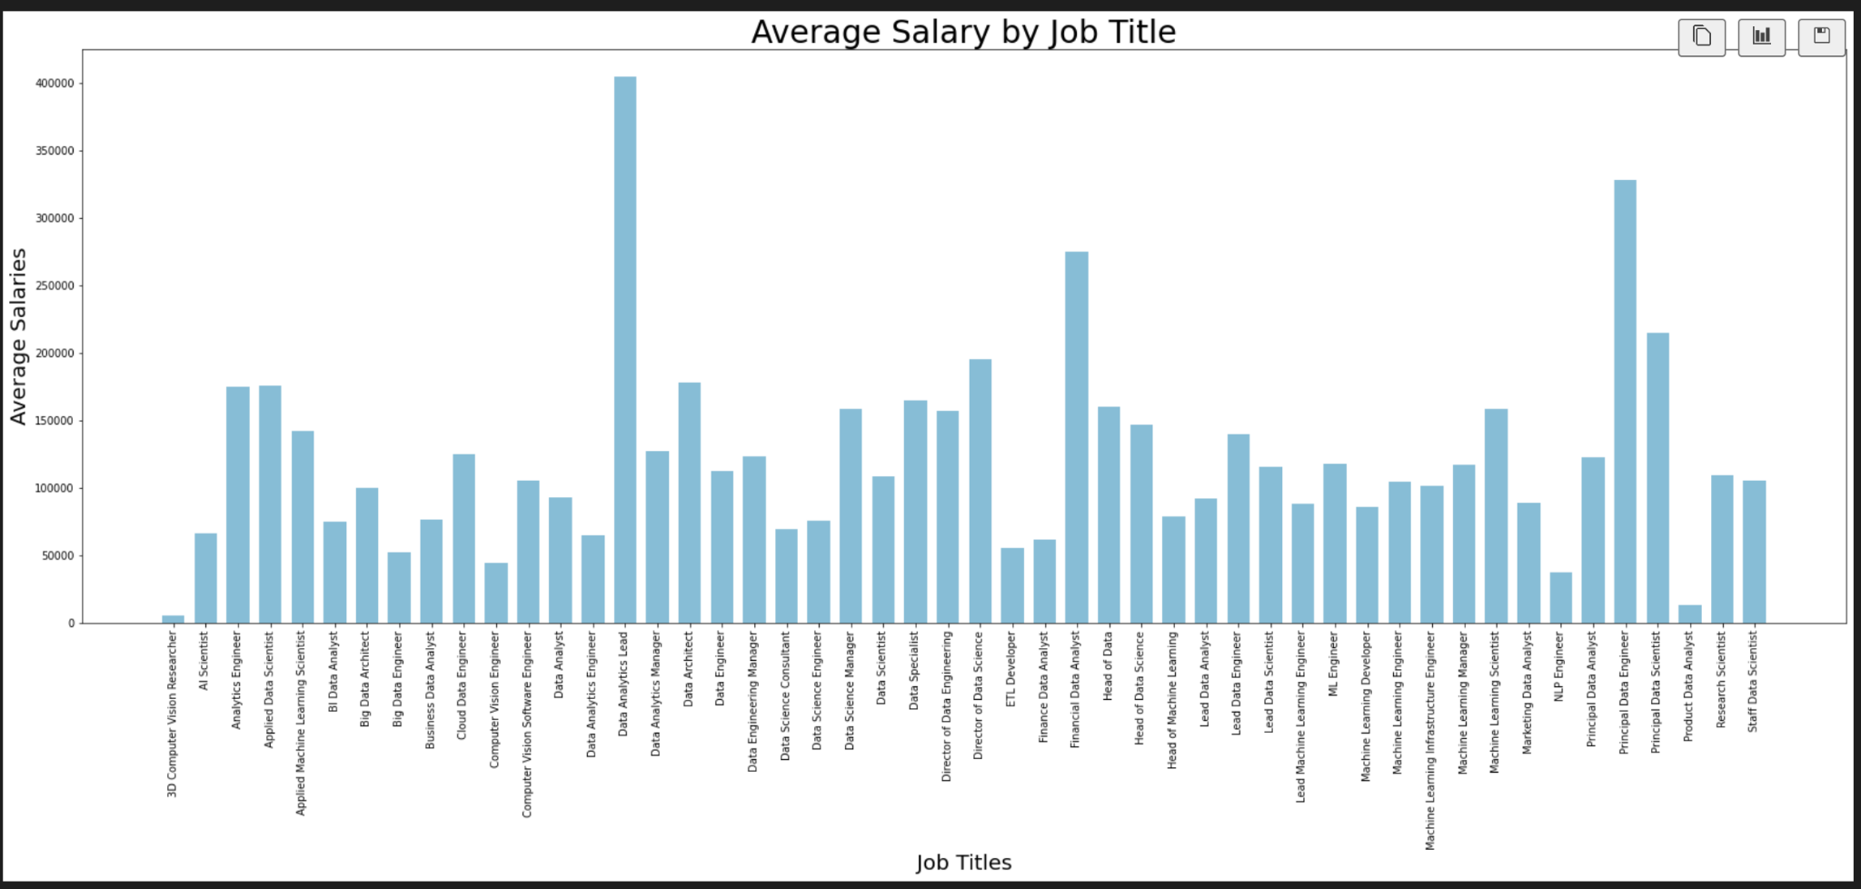
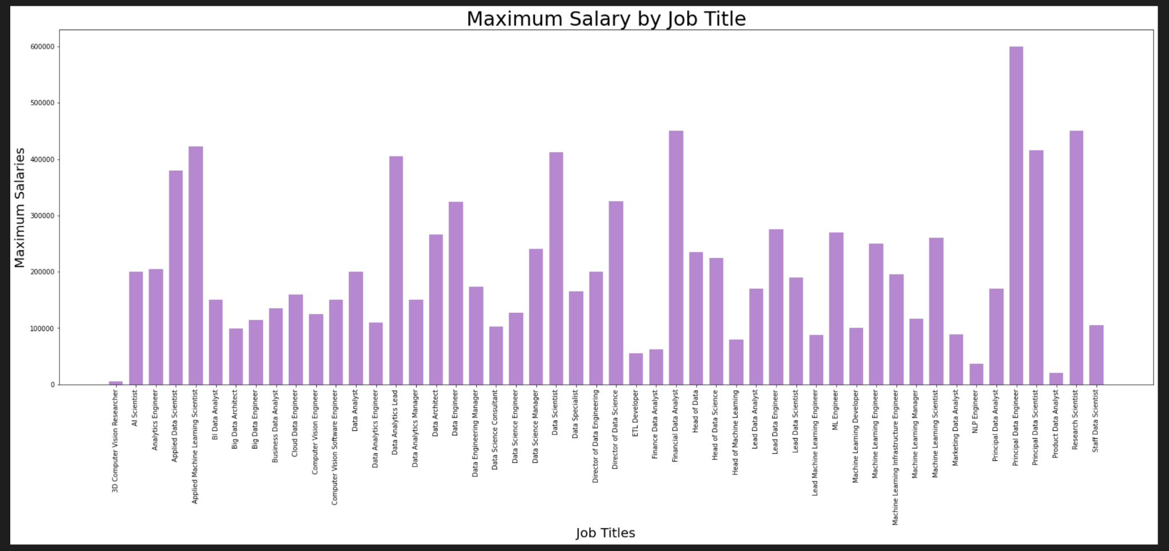
Statistics and Visualisation (By Job Title)

Slide 14
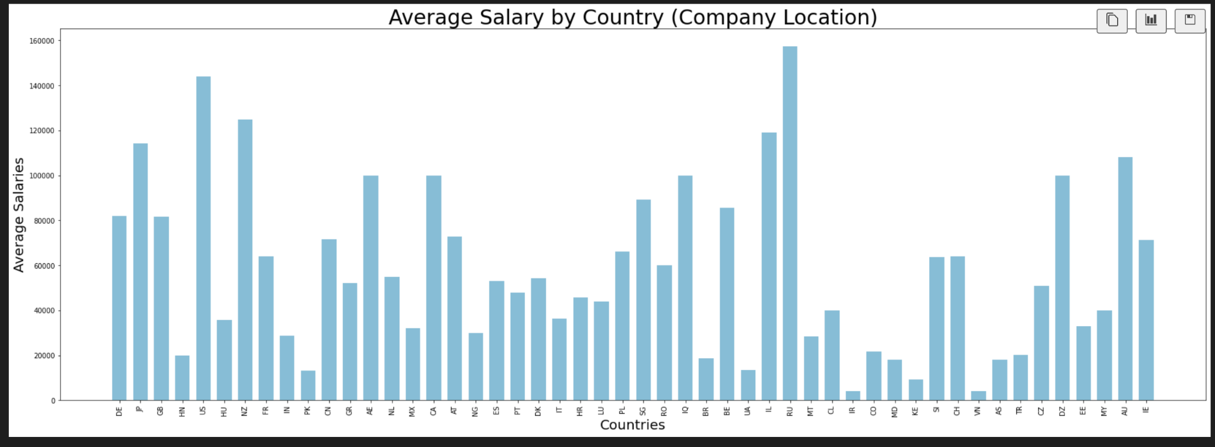
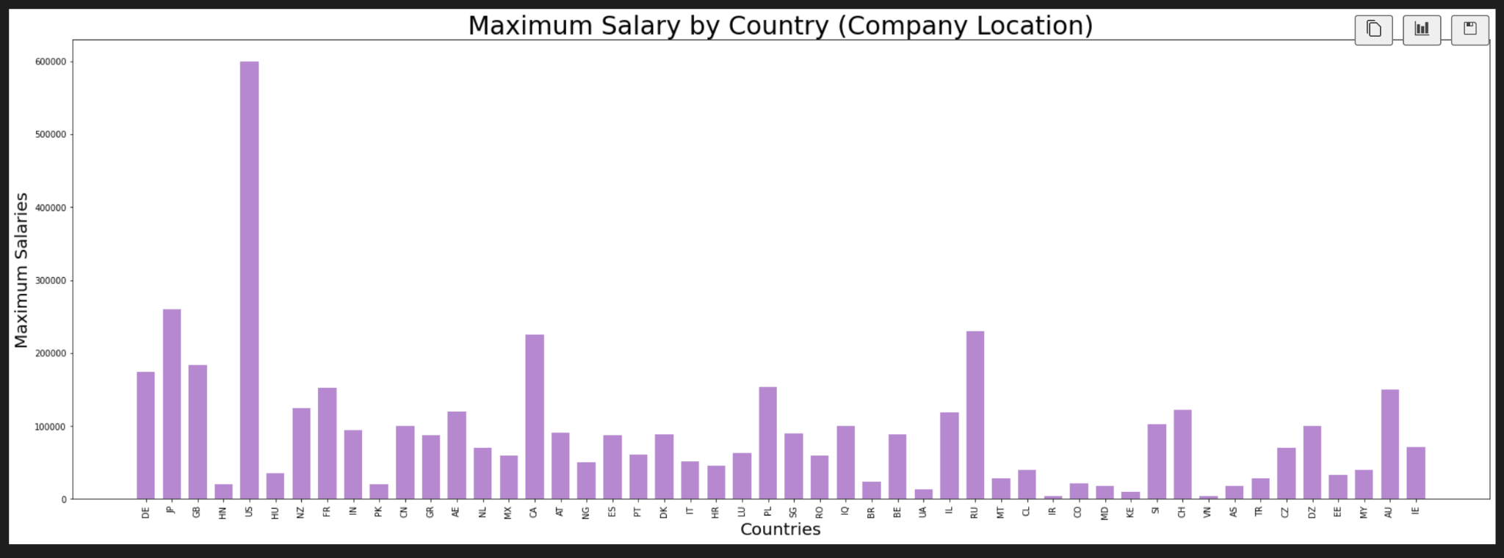
Statistics and Visualisation (By Country)

Slide 15

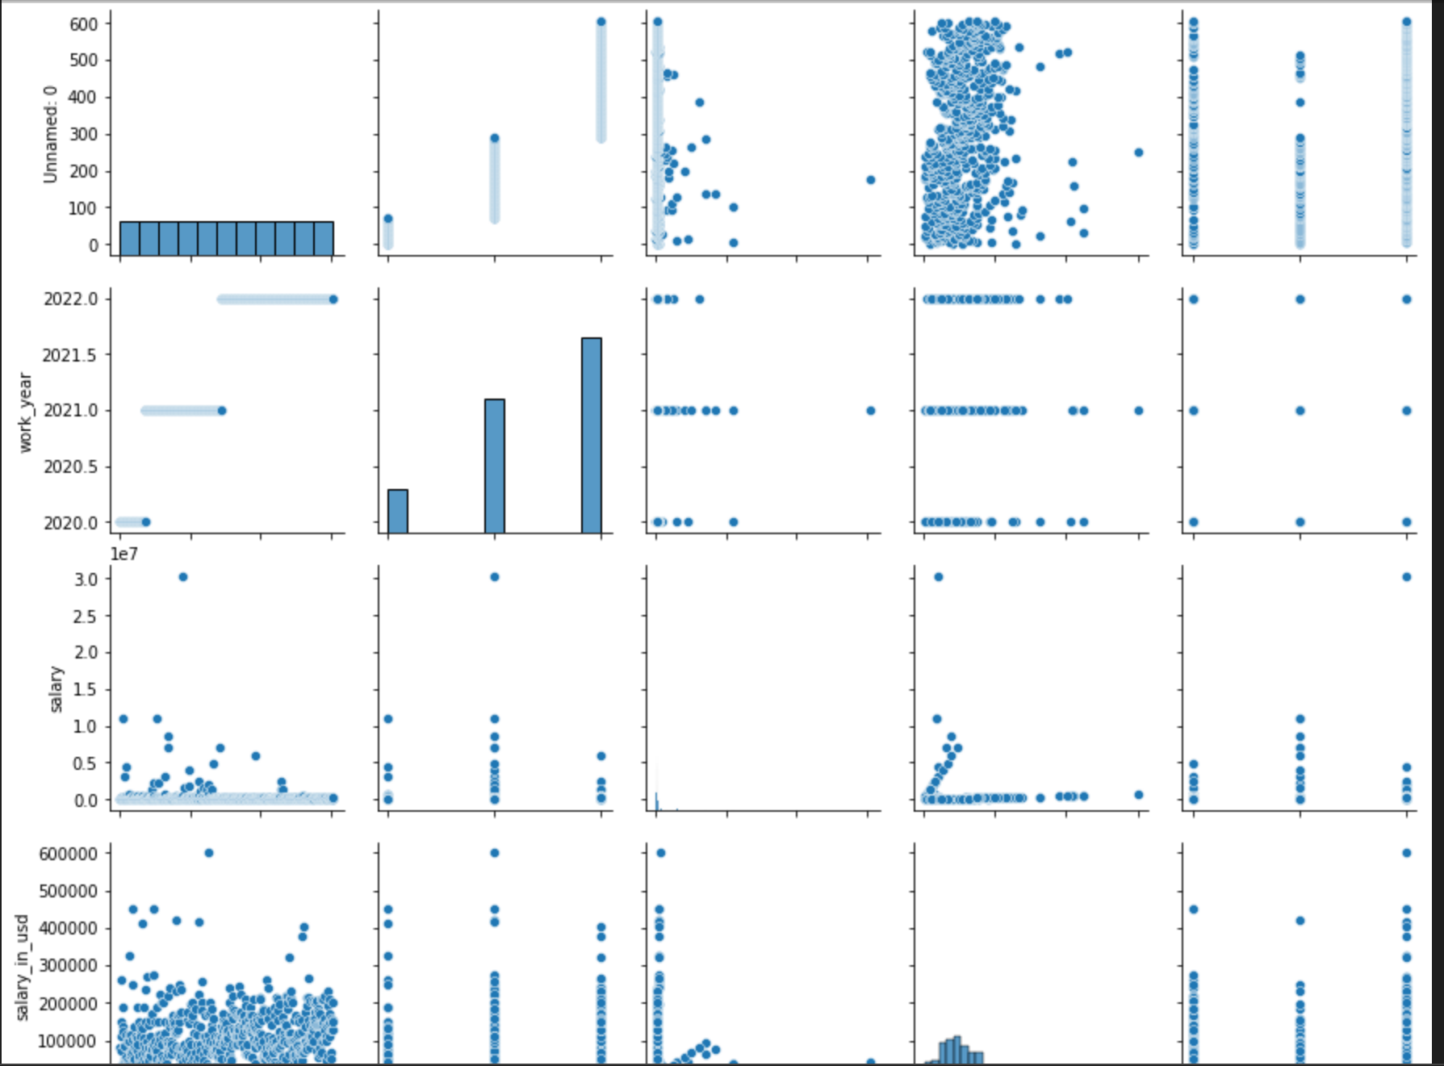
SEABORN: SCATTER PLOTS
pairs all the features and produces scatter plots for every combination of two features in the dataset

Slide 16

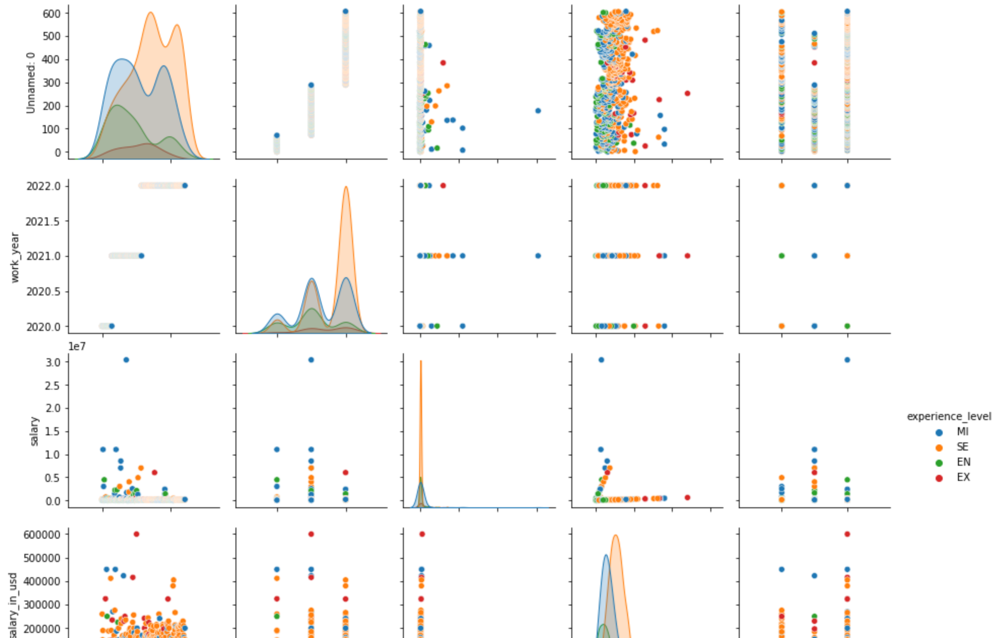
SEABORN: SCATTER PLOTS
The same thing, but the data points are distinguished by experience level
(entry level is not looking too bad guys!)

Slide 17
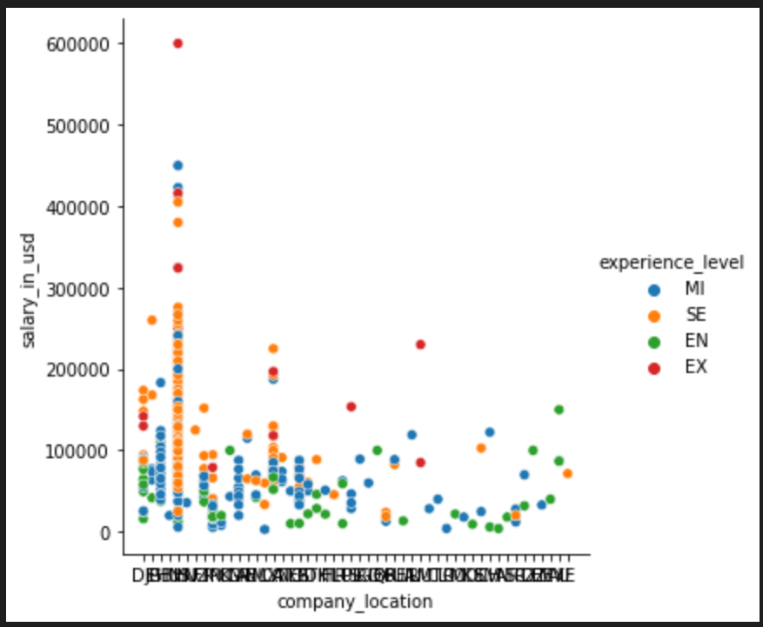
SEABORN: SCATTER PLOTS
Here’s one of the many scatter plots: comparing company location against salary, and distinguishing between the points by experience level

Slide 18
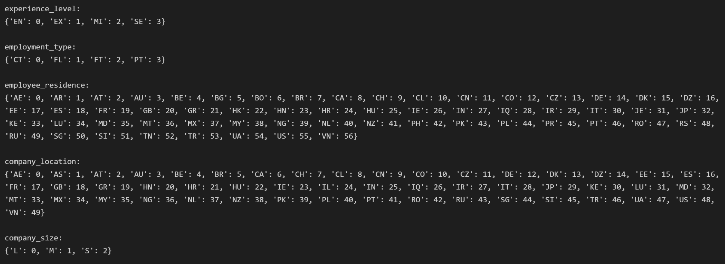
Non-numeric → numeric data (LabelEncode)

Slide 19
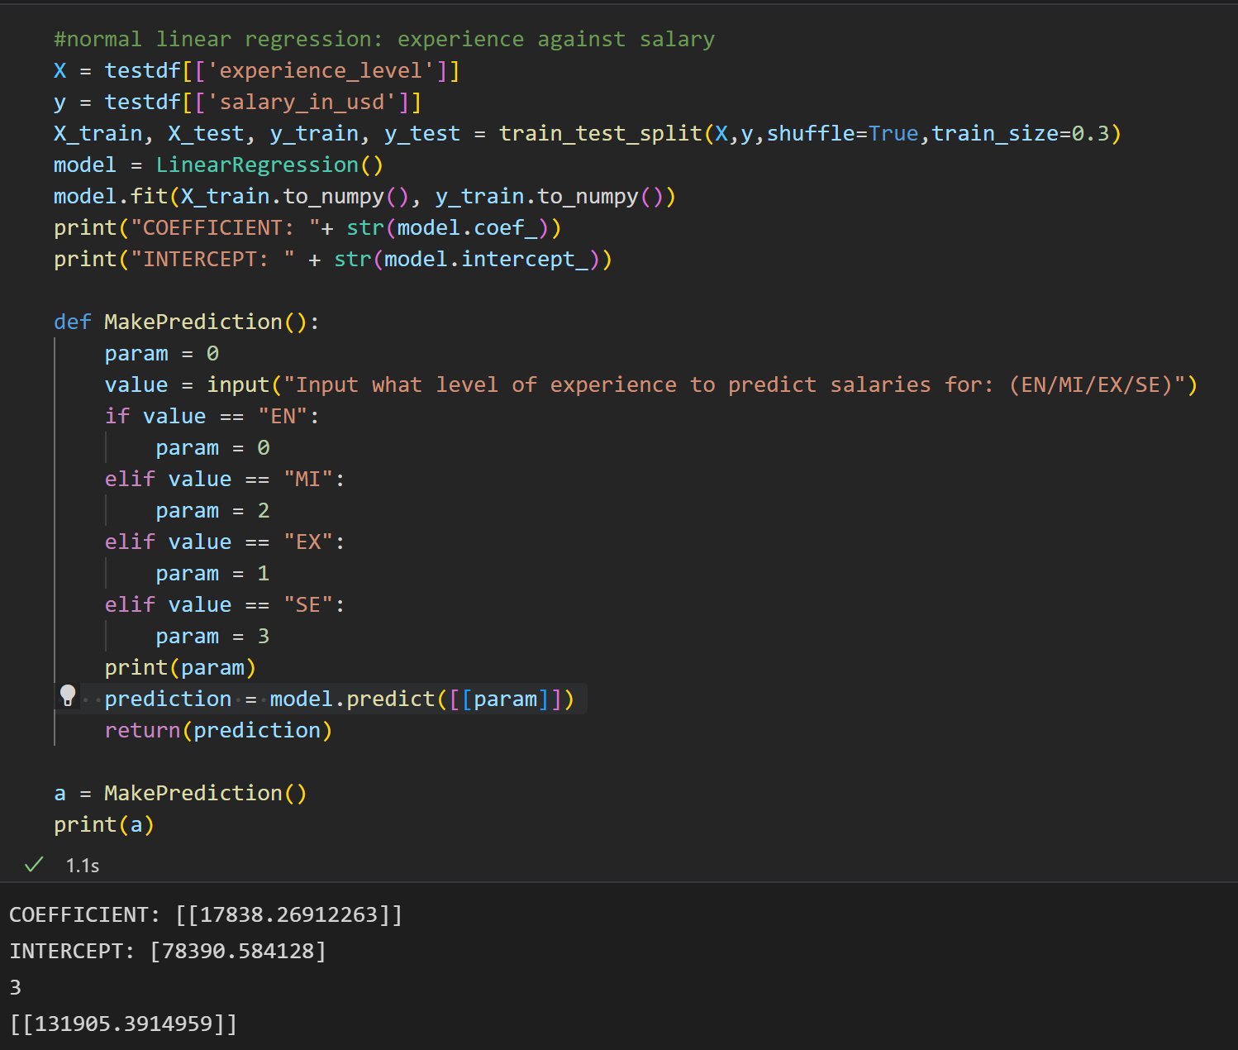
Linear Regression

Slide 20
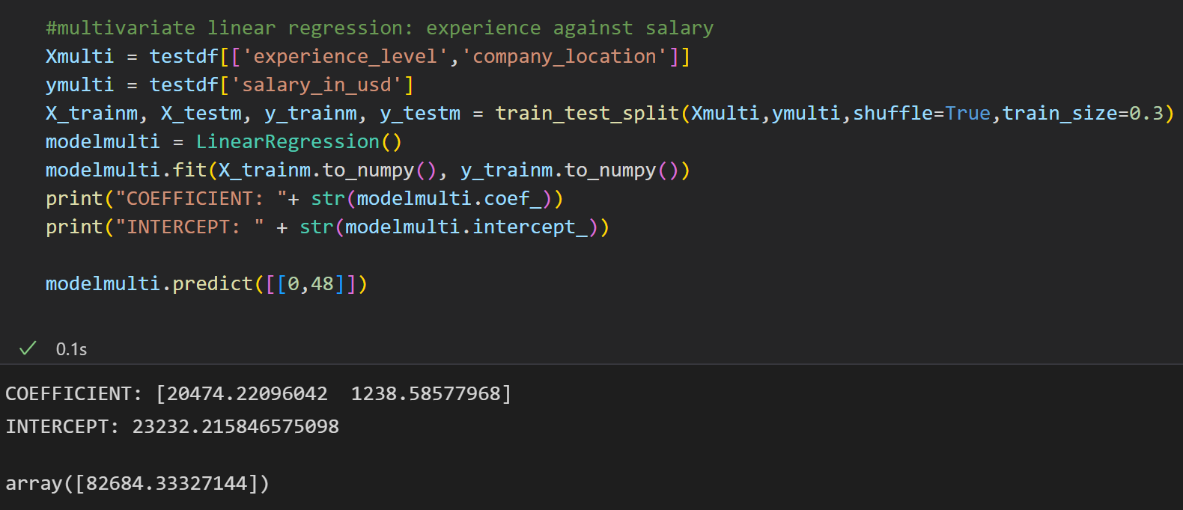
Multivariate Regression

